Slide 1

Effective Medical Diagnosis
AUSTIN GNANARAJ NOAH
ADVANCES IN DATA SCIENCES & ARCHIETECTURES

Slide 2
Problem Statement
“Doctors’ Diagnostic Errors Are Often Not Mentioned But Can Take A Serious Toll”
-kaiserhealthnews
Diagnoses that are missed, incorrect or delayed are believed to affect 10 to 20 percent of cases, far exceeding drug errors and surgery on the wrong patient or body part, both of which have received considerably more attention.
A 2009 report funded by the federal Agency for Healthcare Research and Quality found that 28 percent of 583 diagnostic mistakes reported anonymously by doctors were life-threatening or had resulted in death or permanent disability

Slide 3
A meta-analysis published last year in the journal BMJ Quality & Safety found that fatal diagnostic errors in U.S. intensive care units appear to equal the 40,500 deaths that result each year from breast cancer.
In 1991, the Harvard Medical Practice Study found that misdiagnosis accounted for 14 percent of adverse events and that 75 percent of these errors involved negligence, such as a failure by doctors to follow up on test results.

Slide 4
Reason
Was the Doctor Negligent?
A misdiagnosis or delayed diagnosis itself is not evidence of negligence.
Skilful doctors can and do make diagnostic errors even when using reasonable care.
The key is determining whether the doctor acted competently, which involves an evaluation of what the doctor did and did not do in arriving at a diagnosis.
This means looking at the "differential diagnosis" method the doctor used in making treatment determinations.

Slide 5
Proposal
Develop a visual representation from reliable or proven health data that contains diseases , diagnostic methods for the diseases and the symptoms associated with the disease.
The doctor will use this representation for his assistance as it would ensure that he is working competently by the books and the knowledge known to man.
Decision time for doctors will be reduced dramatically as the possibilities and related tests to clear out confusions is known.

Slide 6
Proposal
The data will learn from new experiences via machine learning.
The visual representation will dynamically alter itself according to the new data.
In order to improve consistency a record must be maintained of the diagnosis in order to learn from misdiagnosis if any.

Slide 7
Steps
Data Extraction
Data Transformation
Data Cleaning
Data Loading
Visual Representation
Describe Key Performance Indicator

Slide 8
Data Extraction
The objective is to extract highly reliable health care data. The data must be known facts and proved by research. The data must cover diseases , diagnoses related to the diseases and the associated symptoms.
In this project we have extracted data via manual web crawling from the following websites.
  http://www.yourheartvalve.com/
  http://www.hopkinsmedicine.org/
  http://www.world-heart-federation.org/
  http://www.healthline.com/
  http://www.webmd.com/
  http://www.heart.org/

Slide 9
Data Transformation/Cleaning
The objective is to transform the extracted data into a desirable form that can be easily processed by the visualization tool.
In the project the extracted data has been transformed using Talend, focusing on the disease types related to the heart, diseases that fall under the type, diagnosis required to identify the disease, the priority for the diagnostic method, and the symptoms associated with the diseases. The output from Talend is in excel format.
Inconsistency in data is cleaned in the transformation process.

Slide 10
Key Performance Indicator
Since the tree already provides the best possible outcome for the diagnosis, the next chance to find the competency of the doctor is by understanding the decision he/she makes.
The most competent doctor would diagnose a disease with fewer diagnosis than one who uses all the diagnosis tests increasing the cost of the treatment and not providing best outcomes for the organization.
The traversal of decision can be further discussed from a visual CART tree.

Slide 11
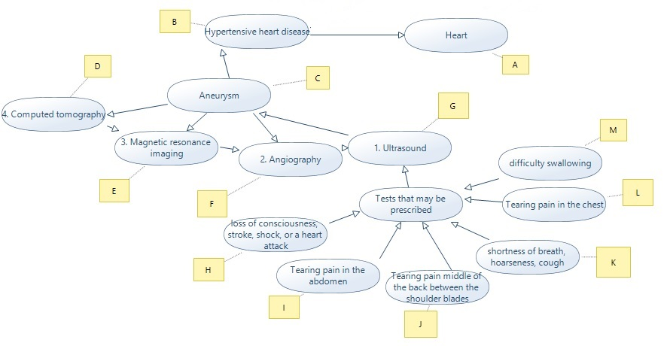
CART

Slide 12
Example
Best Case
Distance(H,A) = 4 (min)
Non- Best Case
Distance(H,A)= 14 (max)
Considering T is constant from one node to another;
% of excess duration taken = ((Steps Taken by doctor-Best Case of diagnosis)/Best Case of diagnosis) * 100
Assuming Steps Taken by doctor = 6
= ((6-4)/4)*100
= 50 %
This value is a reference and can be used to determine the competency of the doctor

Slide 13
Performance Indicator
The distance travelled between the patient’s symptoms to the doctor’s diagnosis decision is the measure of doctor’s competency to diagnose.
The shortest distance when travelled to diagnose a disease in a patient is the best outcome.
The longest distance travelled to diagnose a disease in a patient is not the best outcome.
Any distance travelled other than these are to be handled separately.

Slide 14
Doctor’s Competency
The Doctor can follow his own decision pattern based on personal experiences
Competent Doctors:
Doctor A (Decision) Diagnosis Pattern = { L , G , C , B , A};
(Travel) = 4;
Doctor B (Decision) Diagnosis Pattern = { L , F, C , B , A};
(Travel) = 4;

Slide 15
Data Learning
Data Learning process will affect the priority of diagnosis in the system. Pseudo
(Decision) Diagnosis Array[doctor] ; // holds decisions of an array doctors
Case Directory;// holds different patterns of cases
Number of days in a year = 365
For(each doctor in the system)
For(each case){
For(each decision of doctor in the system in a year){
if(Decision Pattern [Doctor]!= Decision Pattern[System])
Threshold %(iterative);
}
If(Threshold % >=99.99){
Modify Decision Pattern[System] = Decision Pattern[Doctor];
}

Slide 16
Case Directory
Case Directory holds the Disease Type, Disease, Symptoms and Symptoms order.
Example : Disease Type – Hyper-Tensive Heart Disease
Disease -- Aneurysm
Case1:
Symptom Pattern : Tearing pain in abdomen , Difficulty swallowing , Tearing pain in the chest , Shortness of breath , cough
Diagnosis(Doctor A) – Ultra Sound, Angiography
Case2:
Symptom Pattern - Shortness of breath , cough, Tearing pain in abdomen , Difficulty swallowing , Tearing pain in the chest
Diagnosis(Doctor A) – MRI , Ultra Sound

Slide 17
Questions
Thank You

